Slide 1
Neuro 140 Final Project
Holden Schermer

Slide 2
GOAL
Can we use machine learning to generate Mario-style platformer levels that are both playable and capture the feel of classic, human-designed levels?

Slide 3
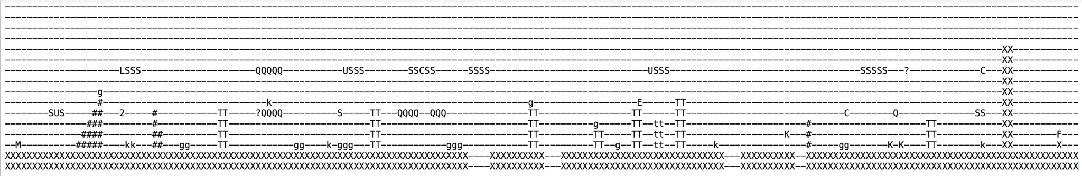
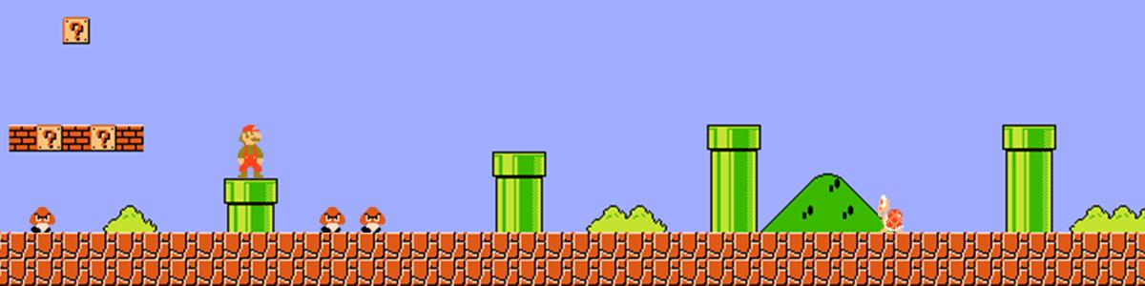
Data

Slide 4
Model Architecture
Why GAN?
Learns implicit level design patterns without explicit rules
Generates diverse outputs while maintaining playability
Controls generation through latent space manipulation
Balances creativity with structural constraints
My Approach:
128-dim noise → 16×16 level patches via convolutional layers
Novel structure penalties:
Ground coverage (60% target)
Gap control (30% gap ratio)
Sky clearing (exponential weighting)
Mid-network noise injection for diversity
Post-processing with configurable difficulty parameters
Patch stitching for full-width levels

Slide 5
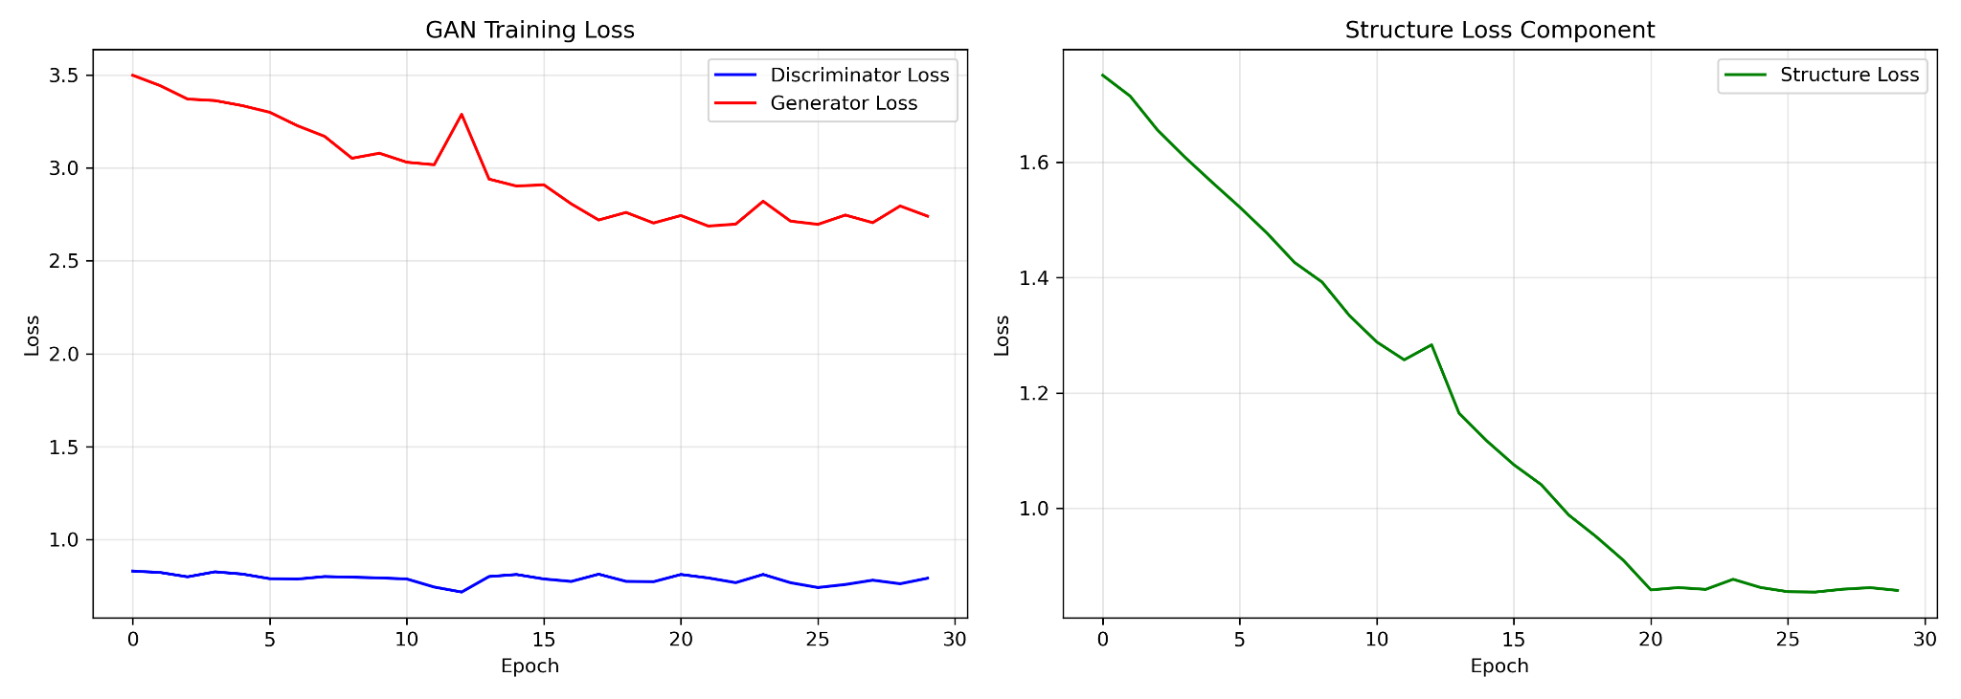

Slide 6
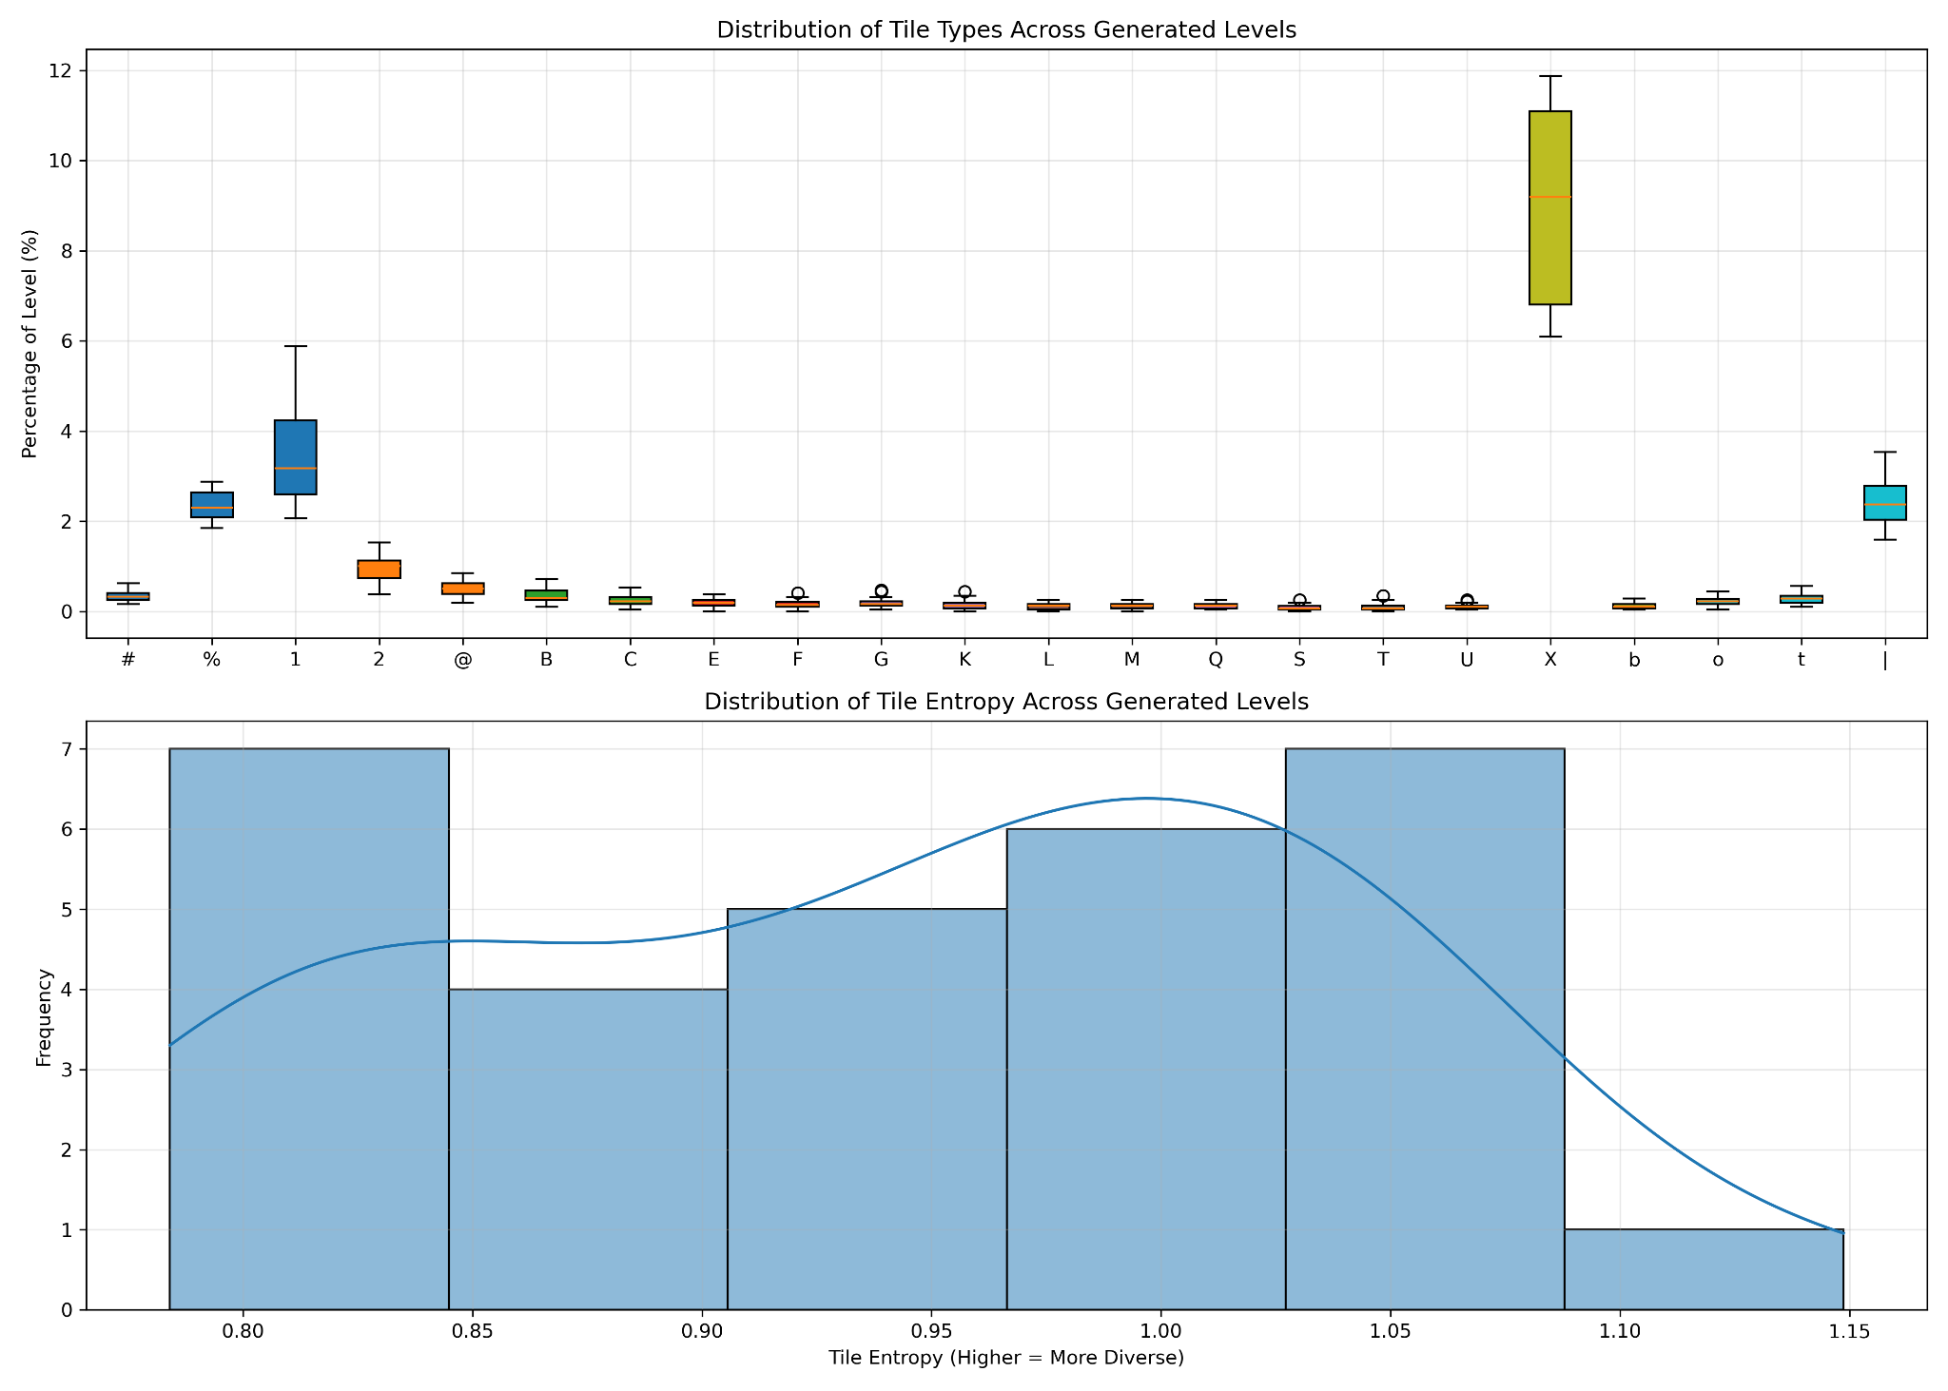
'M': Mario Starting Position
'F': Mario finish line
'y': Spiky
'Y': Winged Spiky
'E' or 'g': Goomba
'G': Winged Goomba
'k': Green Koopa
'K': Winged Green Koopa
'r': Red Koopa
'X': Ground Block
'#': Pyramid Block
'%': Jump through platform
'|': Background for the jump through platform
'*': Bullet bill
'B': Bullet bill head
'b': Bullet bill neck or body
'?' or '@': Special Question block
'Q' or '!': Coin Question block
'1': Invisible 1 up block
'2': Invisible coin block
'D': Used block
'S': Normal Brick Block
'C': Coing Brick Block
'U': Mushroom Brick Block
'L': 1 up Block
'o': Coin
't': Empty Pipe
'T': Pipe with Piranha Plant in it
'<': Top left of empty pipe
'>': Top right of empty pipe
'[': Left of empty pipe
']': Right of empty pipe

Slide 7
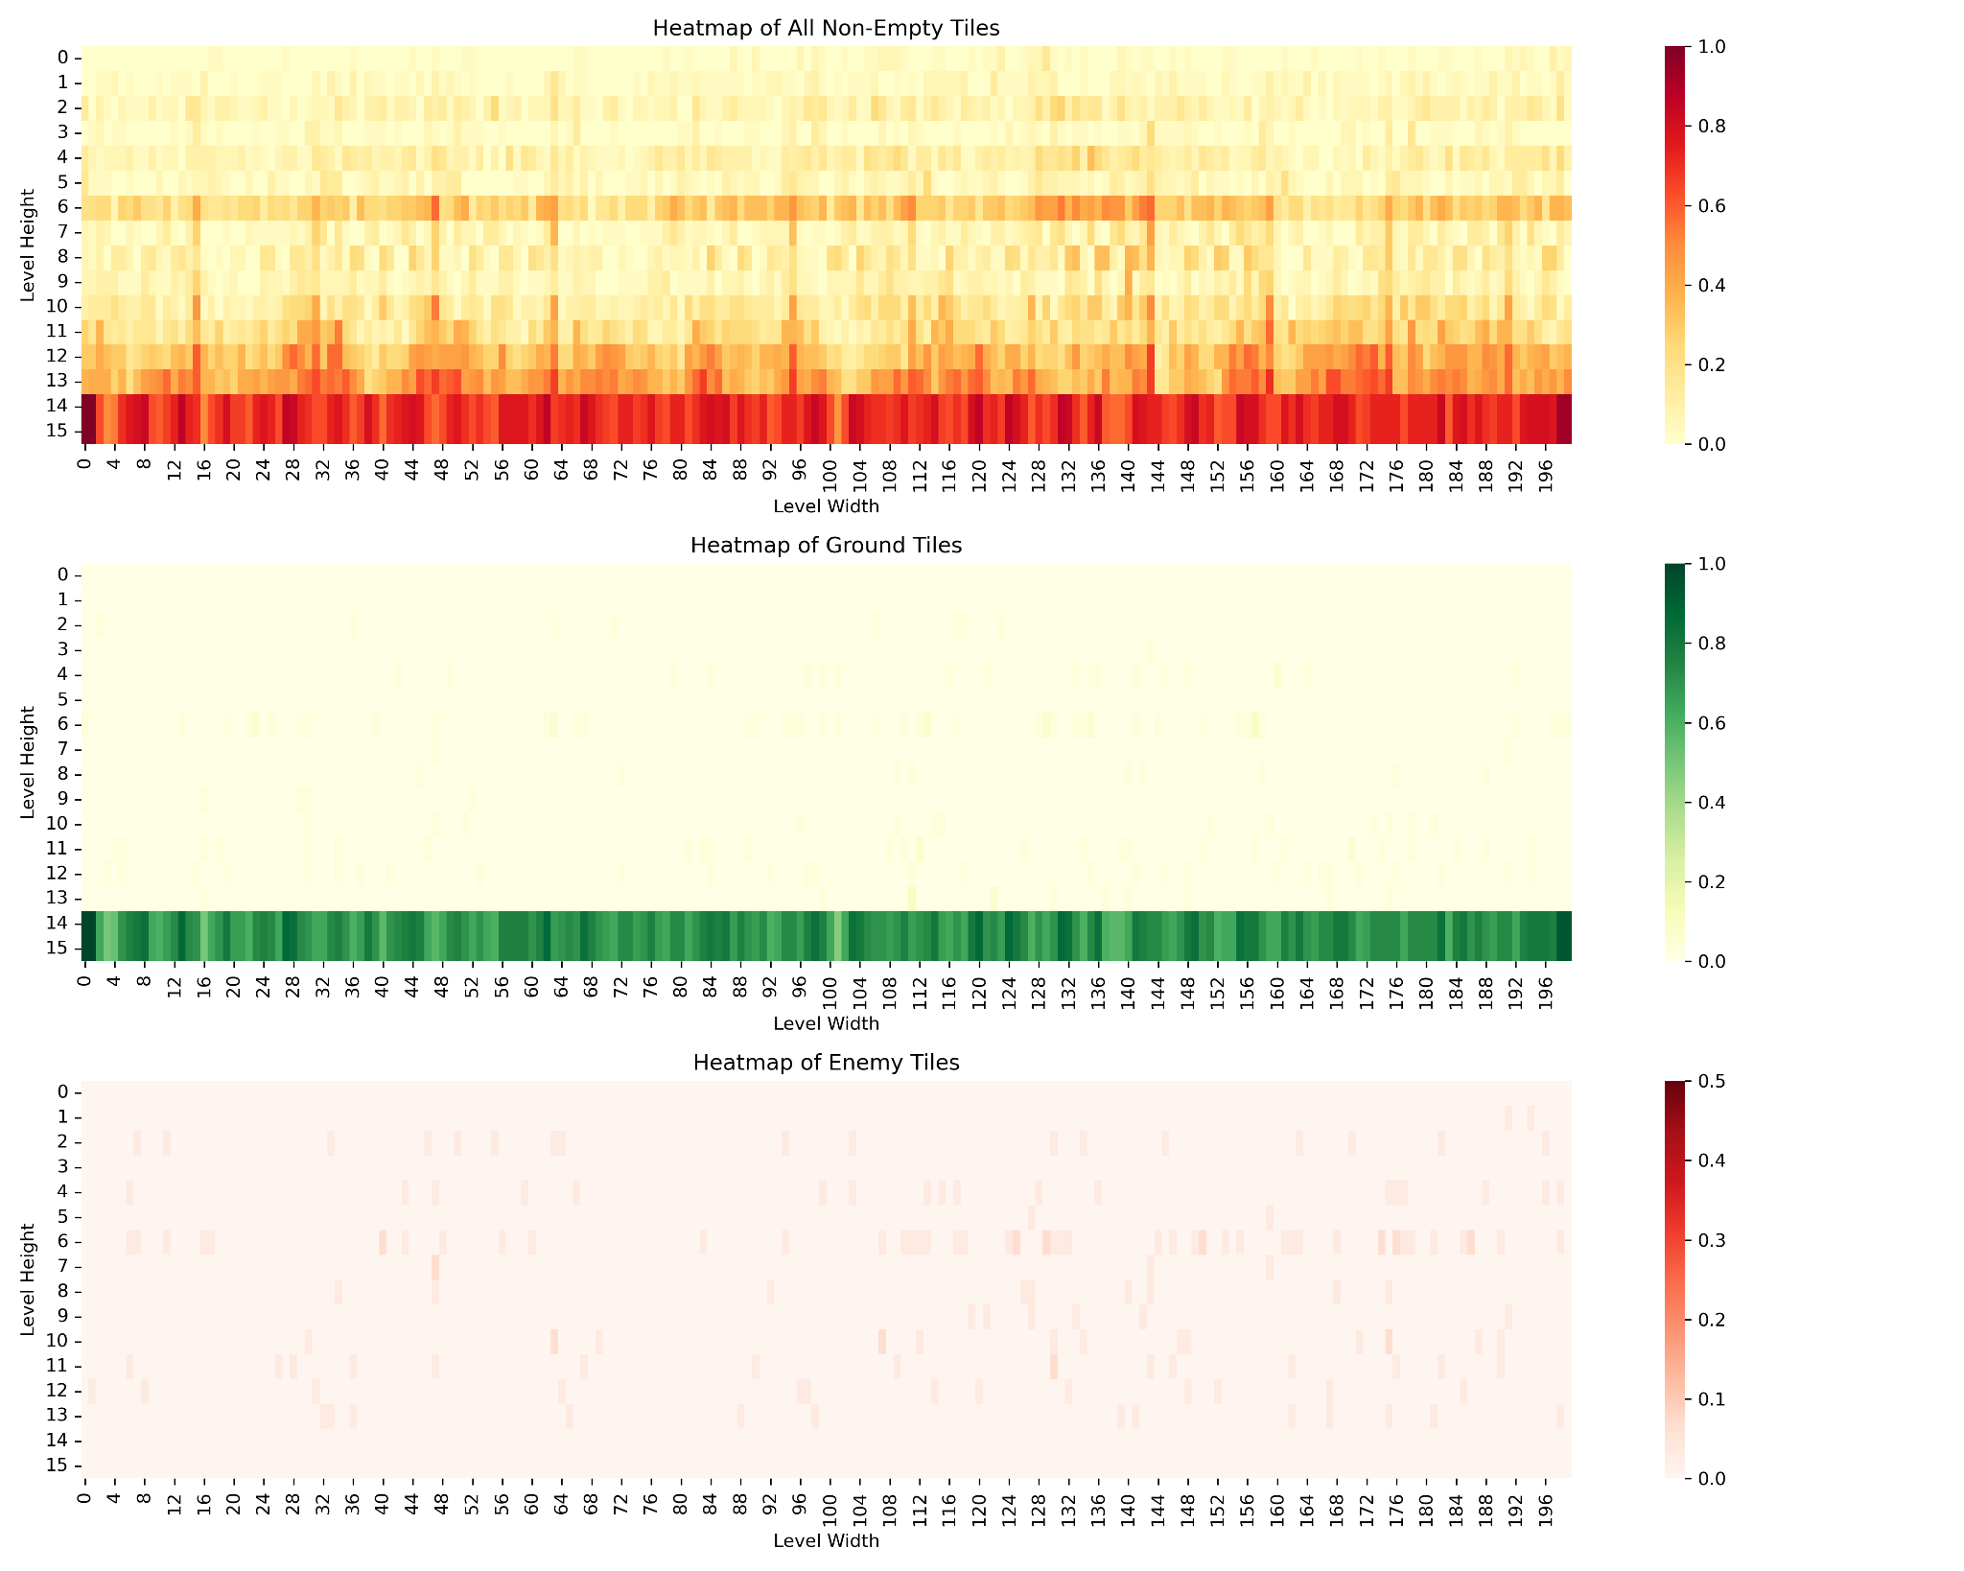

Slide 8
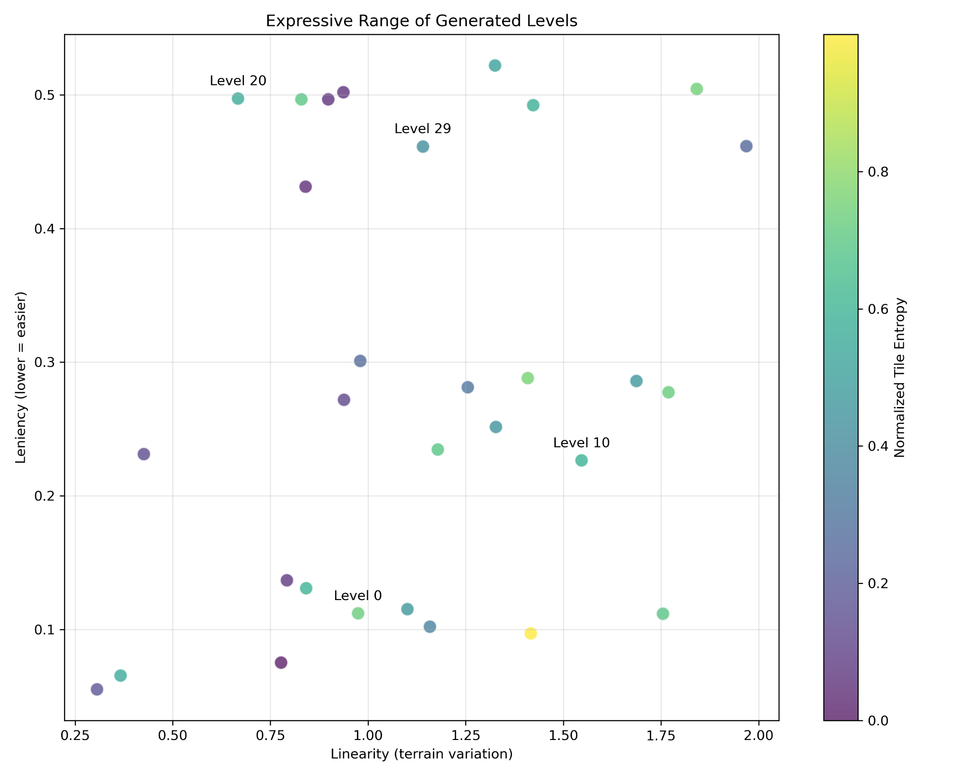
Linearity: standard deviation of ground heights across level columns
Leniency: combined measure of hazards including enemy count and pit frequency and size Entropy: Statistical diversity of tile types

Slide 9
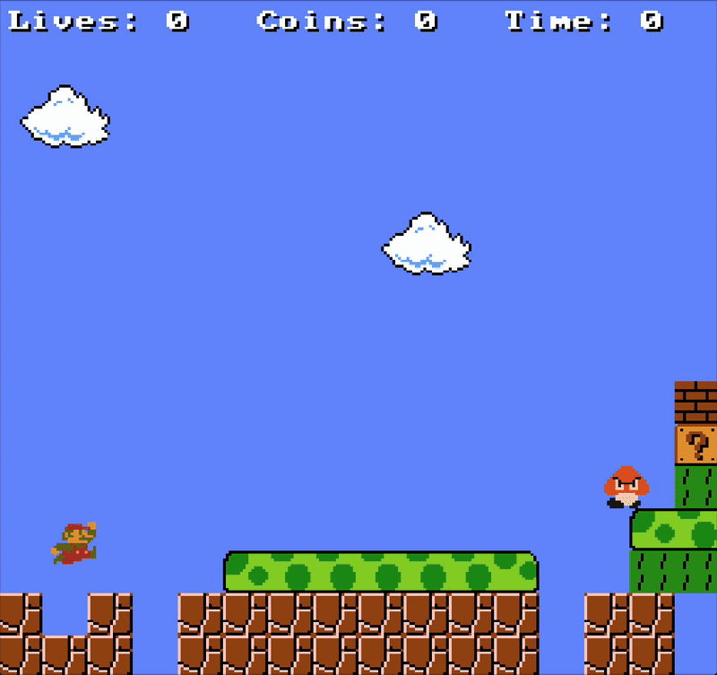
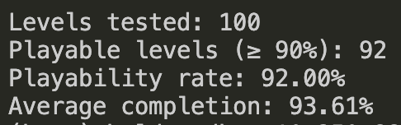
Conclusions
92% Playability
Playability satisfied, but creating levels that feel coherent and resemble human-designed gameplay remains a challenge.

